Slide 1

Introduction
Center for Health Data Science

Slide 2
Agenda
2
3
Experimental planning
Workshop data
Who are we?
1
About this course
Ucloud setup
4
5

Slide 3

Who are we?
Center for Health Data Science (HeaDS)
The Data Lab
Provides data science support for all research groups at SUND
Organizes workshops/seminars
Research Units
work on different areas and topics within the field of health data science
Sandbox
Facilitating training and use of bioinformatic tools in data science

Slide 4

Who are we?
A national infrastructure with non-sensitive health
data
Researchers and students in health data science need a ‘laboratory’ containing:
Data
Tools for data science
(AI software etc.)
Data types
Supercomputing power
Simulated
Public domain
GDPR compliant
Target 1: Mitigating the person-sensitive nature of health data
Anonymised

Slide 5
Who are we?
A national infrastructure with non-sensitive health
data
Researchers and students in health data science need training in:
Data carpentry/engineering
Tool/model mechanics & implementation
Data types
HPC options / best practices
Public domain
Simulated
GDPR compliant
Target 2: Onboarding students to advanced computing projects
Anonymised

Slide 6
Who are we?
Sandbox
Data
Open source
Synthetic data
Modelled data
Tools
&
Services
Sandbox structure
“Weak” Firewall
Easy access to sandbox for students and employees at Danish universities (with accessible funding)
User 1
Environment
User 2
Environment
User 3
Environment
User 4
Environment
User 5
Environment
User N
Environment
Easy transition to protected environment
Straight-forward to move from sandbox to a real project, once you are granted access to real (sensitive) data
Sensitive Health Data X
Sensitive Health Data Y
“Strong” Firewall
…
Tools
Data
Tools
Data

Slide 7



Who are we?
Sandbox structure
National
Health Data Science
Sandbox
Easy access to sandbox for students and employees at Danish universities (with accessible funding)
Straight-forward to move from sandbox to a real project, once you are granted access to real (sensitive) data

Slide 8



Who are we?
Acknowledgements
Hugo Tavares – Bioinformatics Training Facility, University of Cambridge
Harvard Chan Bioinformatics Core (HBC), Harvard University
Samuele Soraggi – Sandbox team, University of Aarhus

Slide 9
About this course
Motivation and goals
Help and train researchers at Panum to be able to analyse their own bulk RNAseq data.
We will show you how to approach bulk RNAseq data:
Normalize your data
Explore PCAs and heatmaps
Find Differential Expressed genes
Annotation of your results

Slide 10
About this course
Time | 18th August | Time | 19th August
09:00-10:00 | Intro and Setup | 09:00-10:30 | Differential Expression Analysis
10:00-10:30 | Experimental planning | 10:30-10:45 | Break
10:30-10:45 | Break | 10:45-12:00 | DEA visualization
10:45-11:15 | Preprocessing | 12:00-13:00 | Lunch break
11:15-12:00 | Data explanation and RNAseq count | 13:00-13:30 | Functional Analysis
12:00-13:00 | Lunch break | 13:30-14:30 | Gene Annotatation and Overrepresentation Analysis
13:00-14:30 | RNAseq normalization | 14:30-14:45 | Break
14:30-14:45 | Break | 14:45-15:45 | Class Scoring
14:45-16:00 | Exploratory analysis | 15:45-16:00 | Workflow summary
16:00-17:00 | Q&A | 16:00-17:00 | Q&A

Slide 11
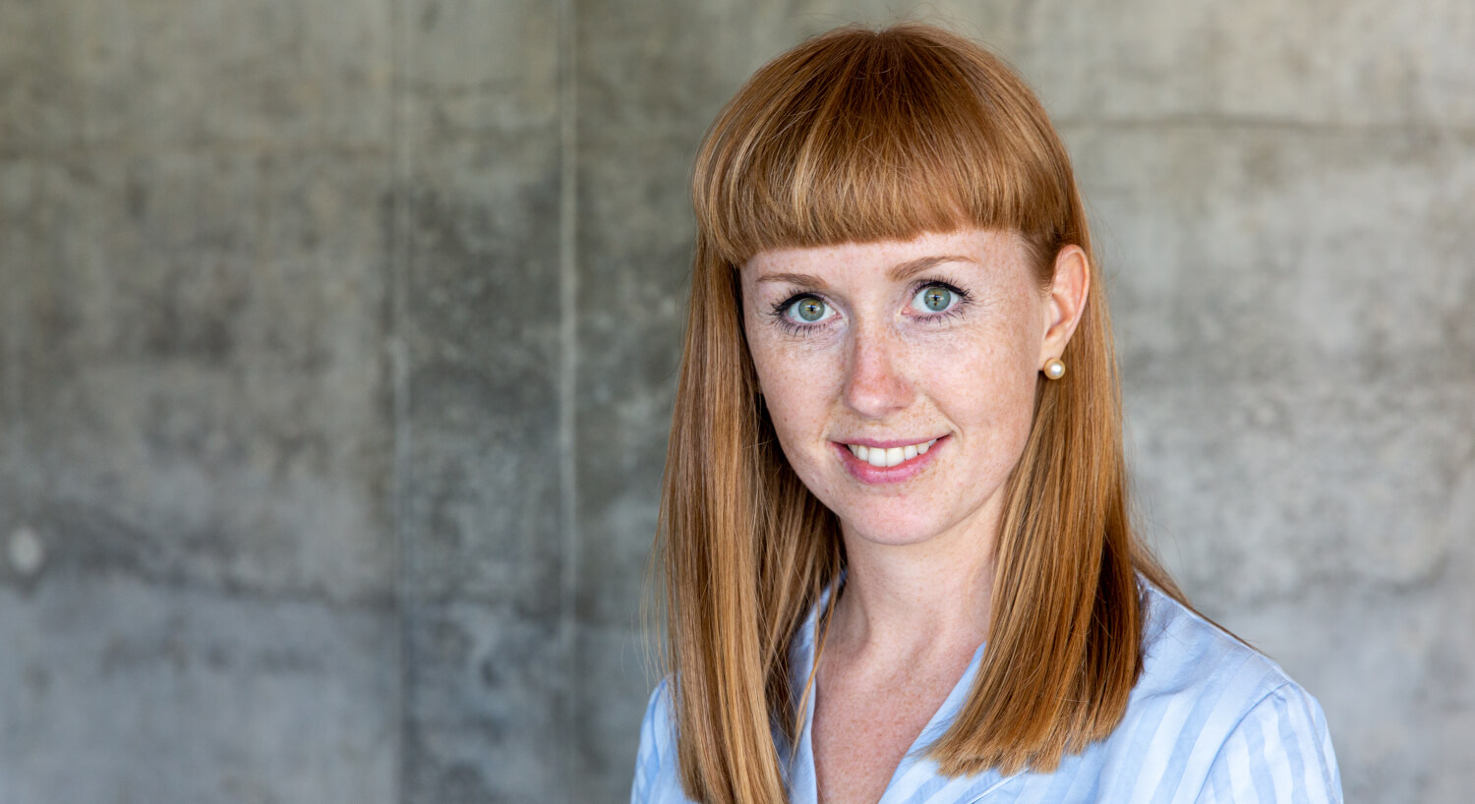
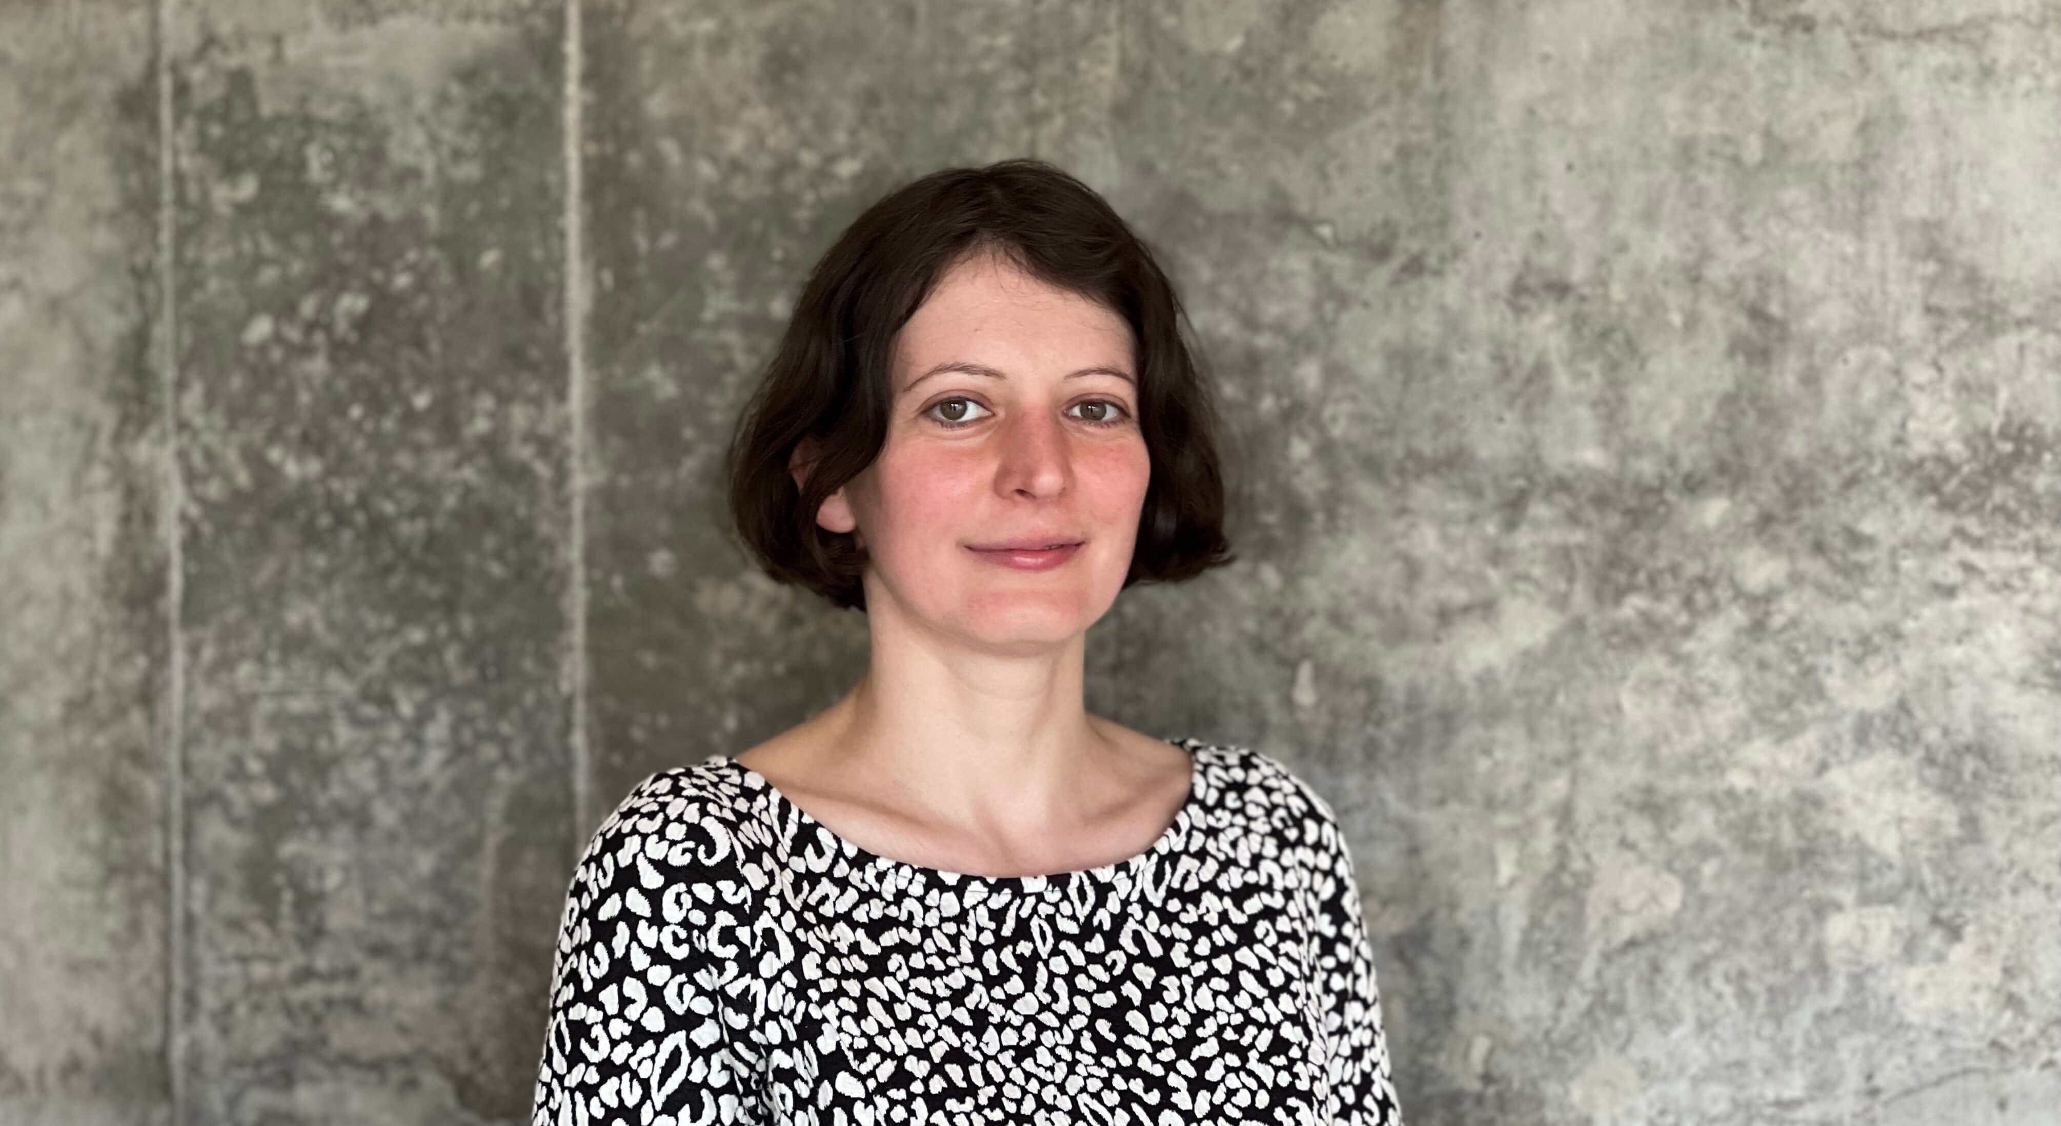
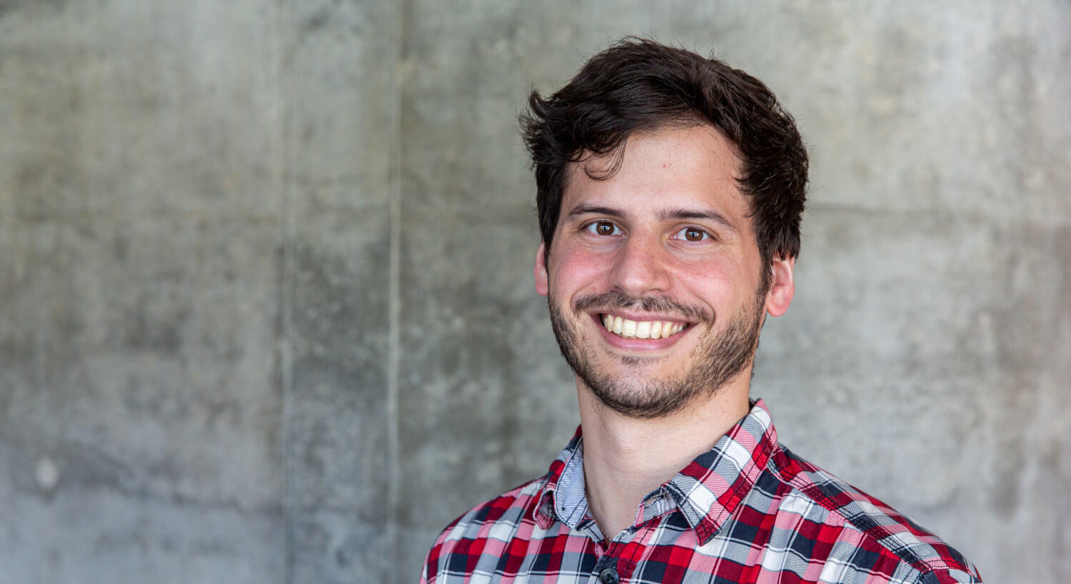
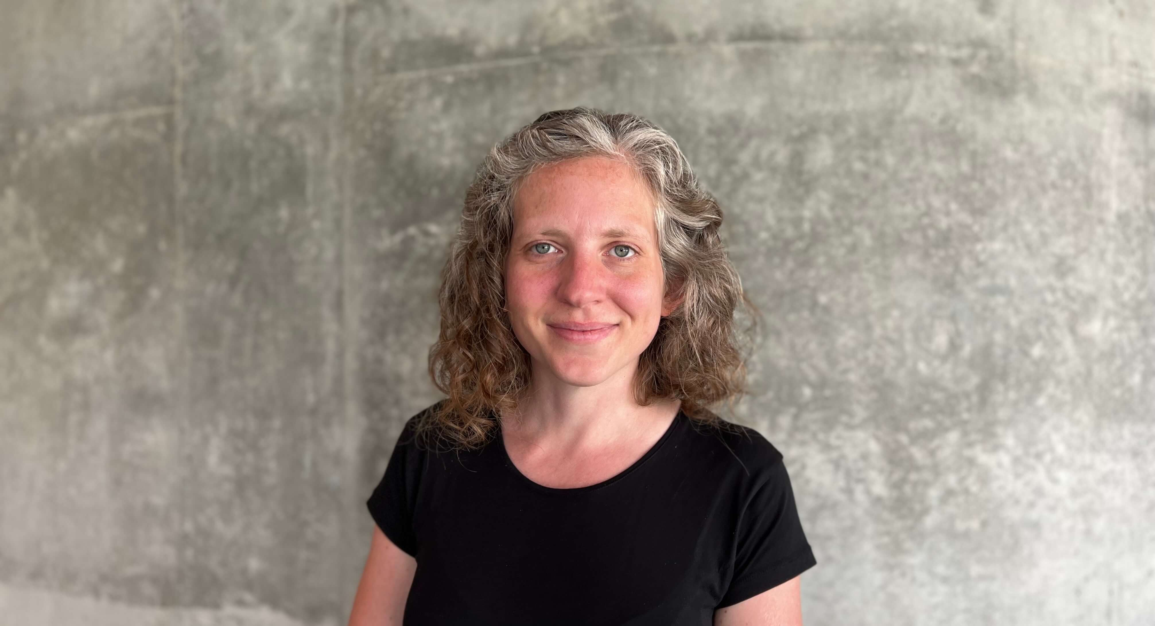
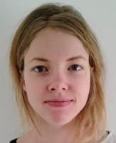
About this course
Your teachers
Thilde Terkelsen
Henrike Zschach
Jose Alejandro Romero Herrera
Jennifer Bartell
Adrija Kalvisa (reNew/CPR)

Slide 12

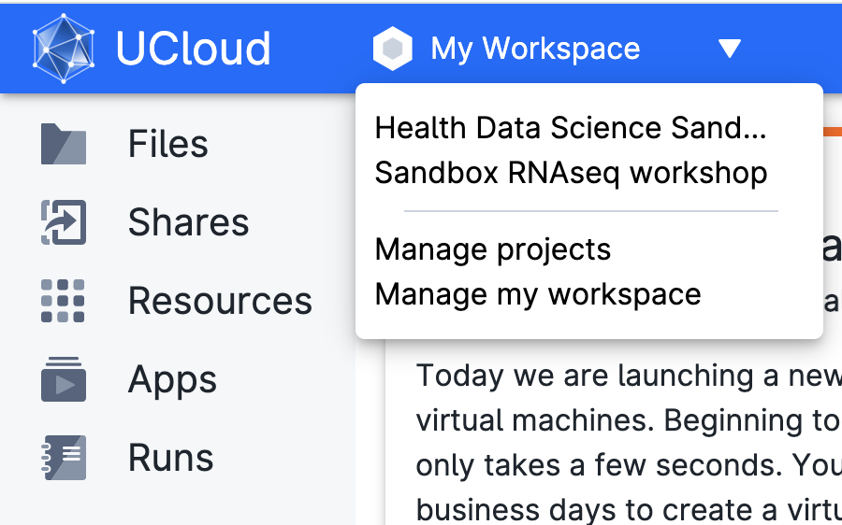
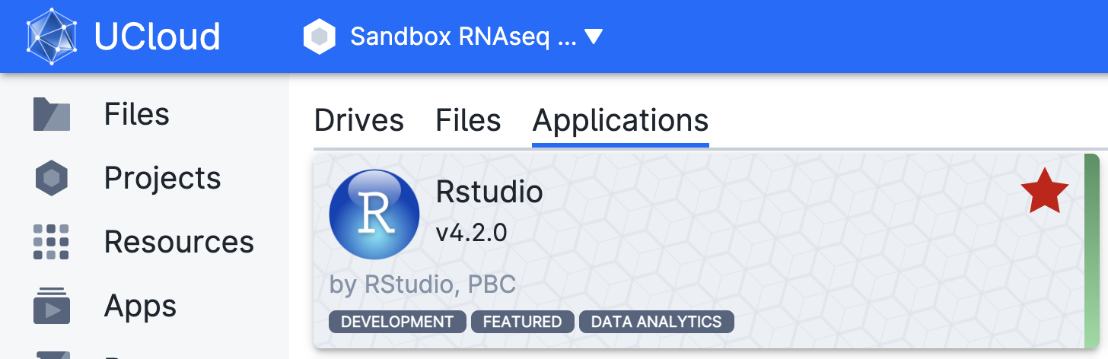
UCloud setup
Highly secure platform for interactive high-performance computing
You should have been added to the Bulk RNAseq workshop project
We will use Rstudio inside Ucloud

Slide 13
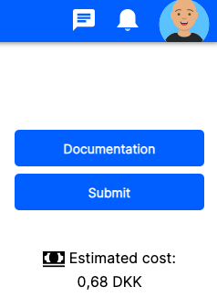
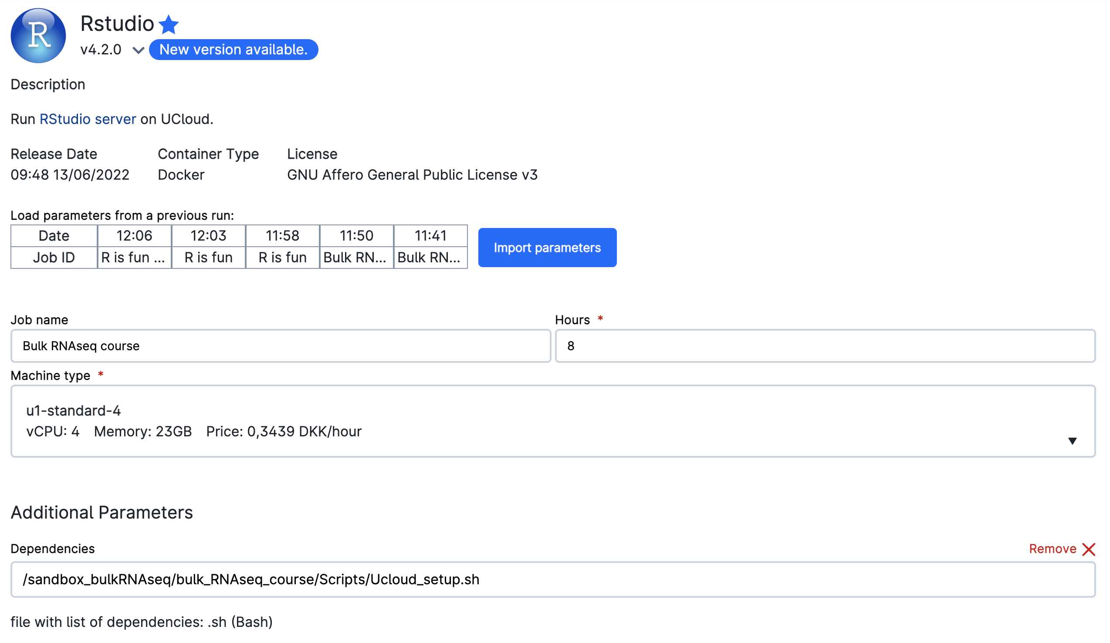
UCloud setup
To start the app, click on the app and import the specified parameters
When ready, click on submit

Slide 14
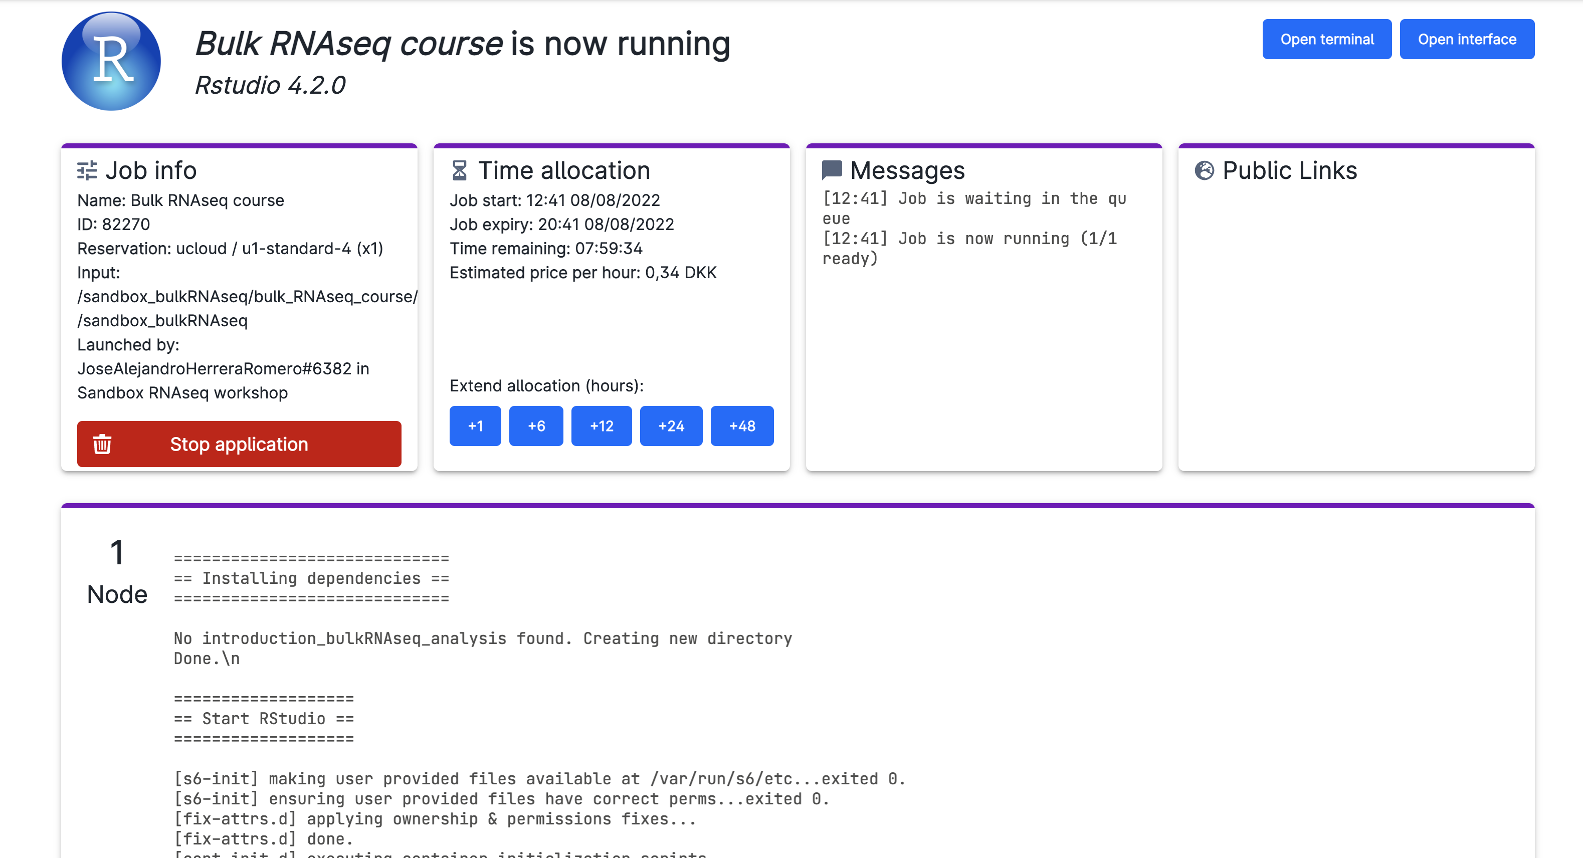
UCloud setup
You should get now a screen like this. Click on open interface!

Slide 15
UCloud setup
Let’s do it together!

Slide 16
Experimental planning
Special considerations to account for before an RNAseq experiment.
Ignoring them will greatly affect the quality of your analysis.
Proper experiment controls
Number and type of replicates
Issues related to confounding
Addressing batch effects

Slide 17
Experimental planning
1. Proper experiment controls
Minimize the effect of irrelevant variables
Control deviations that might influence outcomes
Types of controls:
Positive: samples that receive a treatment with a known result
Negative: samples where no response is expected

Slide 18
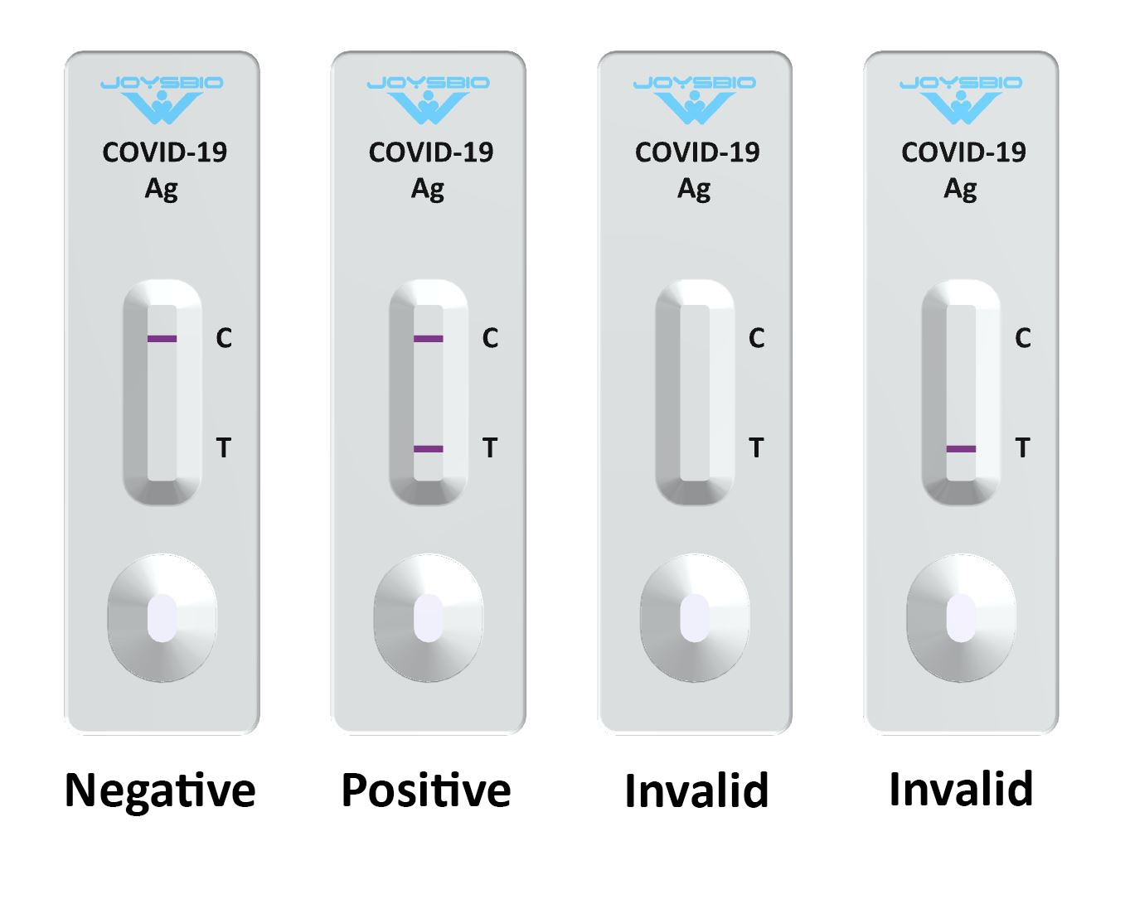

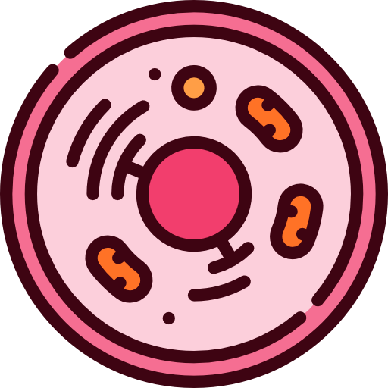
Experimental planning
1. Proper experiment controls. Examples
Covid tests: Positive control
Gene knockout: negative control
Water
CRISPR knockout

Slide 19
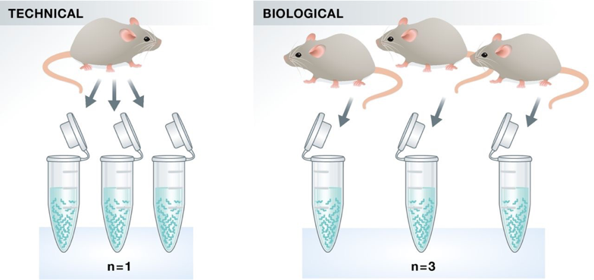
Experimental planning
2. Number and type of replicates
Needed to account for variation between samples
Types:

Slide 20
Experimental planning
2. Number and type of replicates
More biological replicates equals to:
better estimates of biological variation
more precise estimates of the mean expression levels
more accurate modeling of our data
identification of more differentially expressed genes

Slide 21
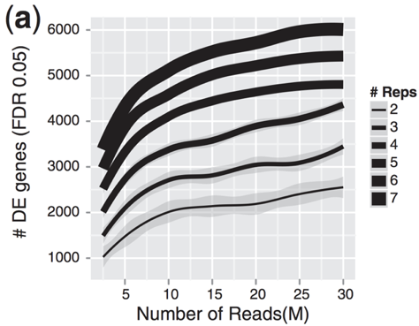
Experimental planning
Number and type of replicates
biological replicates > sequencing depth
Depends on your experiment though
more replicates = more differentially expressed genes with greater confidence
Liu, Y., et al., Bioinformatics (2014) 30(3): 301–304

Slide 22
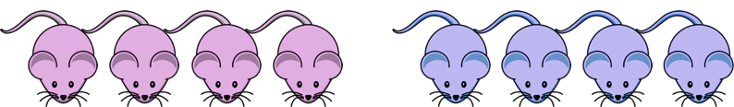
Experimental planning
3. Issues related to confounding
Avoid situations where we cannot distinguish the separate effects of two different sources of variation.
Control
Treatment
Male mice
Female mice

Slide 23
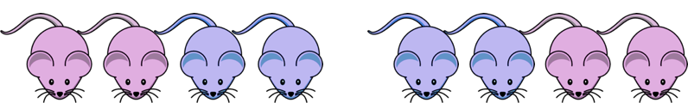
Experimental planning
3. Issues related to confounding. How to avoid:
Subjects and conditions are the same
Split equally between groups of samples
Control
Treatment

Slide 24
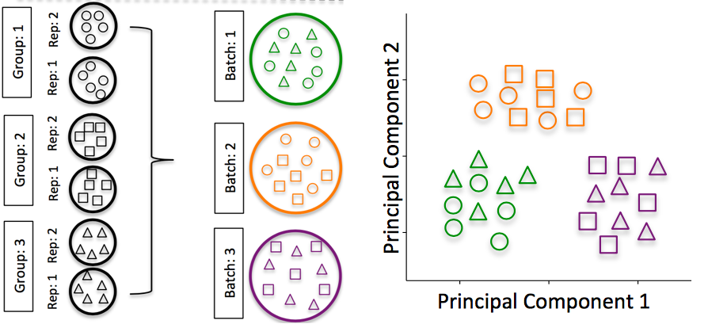
Experimental planning
4. Addressing batch effects
Unwanted variance as consequence of technical issues such as sample collection, storage, experimental protocol, etc.
Hicks SC, et al., bioRxiv (2015)

Slide 25
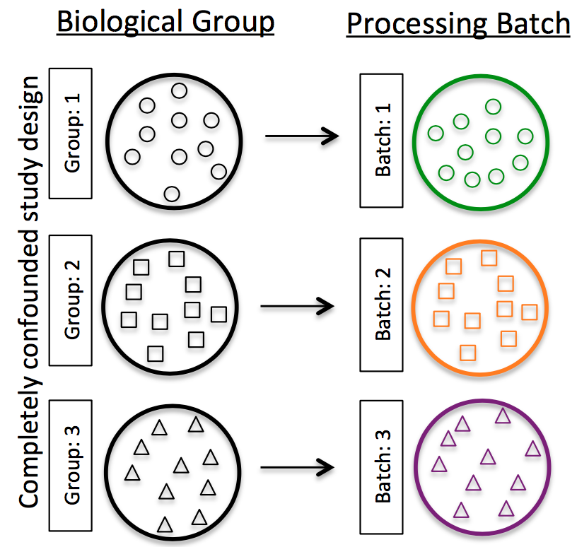
Experimental planning
4. Addressing batch effects. DON’Ts
DON’T confound by processing batch
DON’T use different reagents
DON’T process in different days
DON’T process in different locations
DON’T mix people
Hicks SC, et al., bioRxiv (2015)

Slide 26
Experimental planning
Control
Treat 1
Treat 2
4. Addressing batch effects. DOs
DO split replicates
DO a balance design
DO include batch information
DO consult a bioinformatician!
Batch 1
Batch 2

Slide 27
Quiz
In plenum
Why is experimental planning important?

Slide 28
Quiz
In plenum
What is a control?
And why do we need it?

Slide 29
Quiz
In plenum
What is a technical replicate?
What is a biological replicate?

Slide 30
Quiz
In plenum
What is confounding?

Slide 31
Quiz
At your table discuss
Is this experimental design good? Why or why not?
Control sample
Cancer sample
Same color = same patient
Hospital 1
Hospital 2
Hospital 3

Slide 32
Quiz
At your table discuss
Is this experimental design good? Why or why not?
Treatment 1
Treatment 2
Control
Same color = same cell line
Batch 1
Batch 2
Batch 3

Slide 33
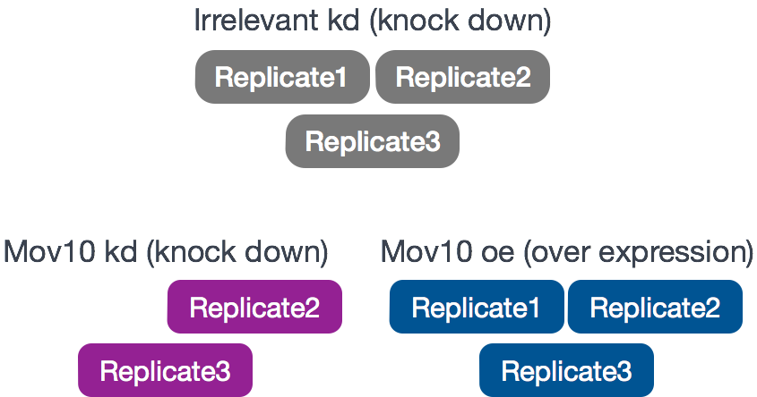
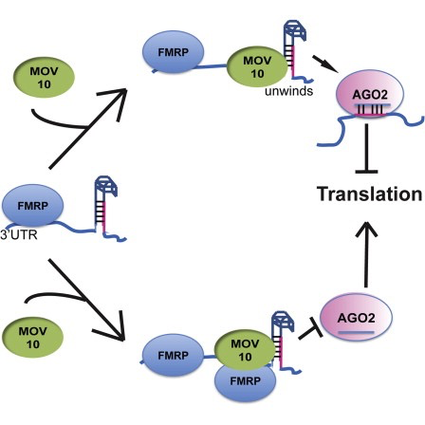
Workshop data
Starting from full count matrix (Kenny PJ et al, Cell Rep 2014)
Fragile X syndrome association between Mov10 and FMRP genes
HEK293F cells
Control
Mov10 transgene
siRNA treatment

